Slide 1
A Discussion of Four Presentations on Some Innovative Contributions of Dr. Ralph Folsom
Phillip S. Kott
philkott1@gmail.com
Selection Confounder Outcome
Variable Predictor
Selection Outcome

Slide 2
Introduction
I received slides for all four presentations in time.
Rod Little
Gauri Datta
Akhil Vaish
Yulei He
After saying a bit about each, I will offer some musings.

Slide 3
Little
As usual, Rod said a lot of sensible things very clearly.
But did he really say that when we know the population total or share of an auxiliary variable but not the individual values of the nonrespondents missingness is not at random?

Slide 4
Datta
Gauri discusses an important problem (ranking small domains) that is not usually given a lot of needed attention.
Personally, I prefer the KWW approach to his.
It requires fewer assumptions.
I thank him for telling me about it.

Slide 5
Vaish
Akhil organized this session and said a lot of nice things about Ralph and his contributions to small-area estimation.
A JSM invited session in 2000 that Ralph and Avi Singh organized changed my life.
Ralph developed calibration weighting and double robustness before Deville and Särndal and before Bang and Robins.

Slide 6
He
Yulei proposes some complex but straightforward
algebra for addressing sensitivity to potential
missing confounders when blending a nonprob
with a prob sample.
I will discuss the missing elephant in the room:
When the key missing confounder is the variable
of interest.

Slide 7
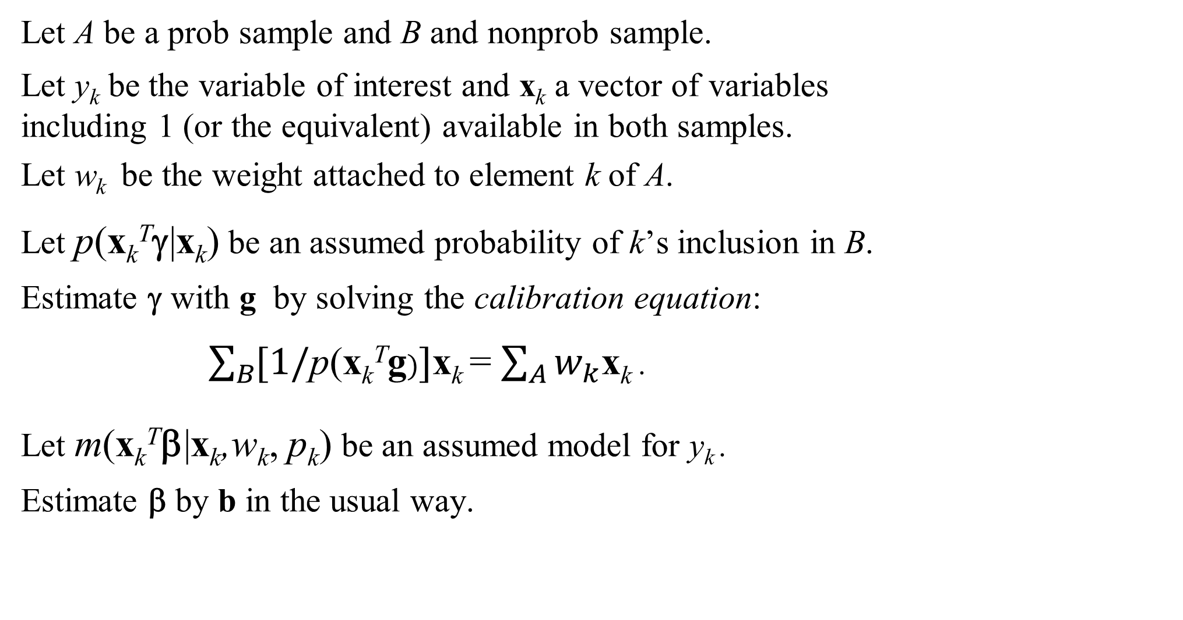
My Approach − Background
Let A be a prob sample and B and nonprob sample.
Let y_{k} be the variable of interest and x_{k} a vector of variables
including 1 (or the equivalent) available in both samples.
Let w_{k} be the weight attached to element k of A.
Let p(x_{k}^{T}γ|x_{k}) be an assumed probability of k’s inclusion in B.
Estimate γ with g by solving the calibration equation:
$\sum_{B}{[\text{1/}\text{p}\text{(}\text{x}\text{k}\text{T}\text{g})}]$x_{k} = $\sum_{A}{w_{k}}$x_{k} .
Let m(x_{k}^{T}β|x_{k},w_{k}, p_{k}) be an assumed model for y_{k} .
Estimate β by b in the usual way.

Slide 8
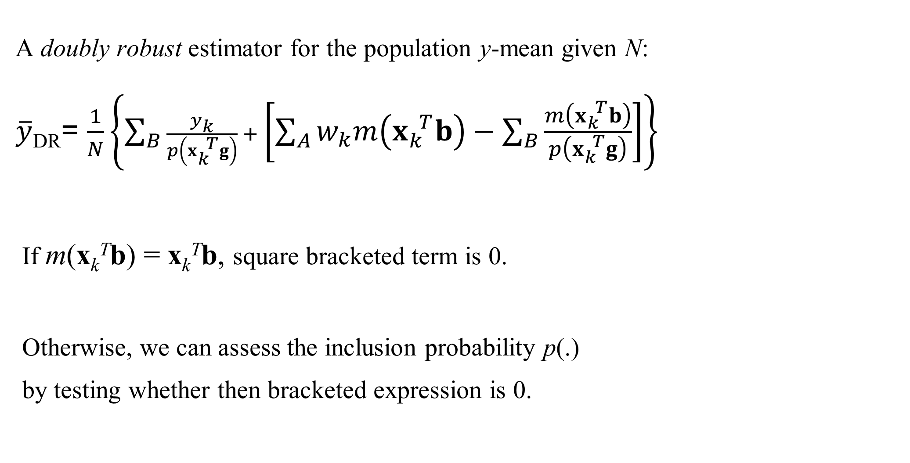
My Approach− Ignorable Models
A doubly robust estimator for the population y-mean given N:
$\overline{y}$_{DR}= $\frac{1}{N}\left\{\sum_{B}{\frac{y_{k}}{p\left(x_{k}^{ T}g\right)} +}\left[\sum_{A}{w_{k}m\left(x_{k}^{ T}b\right)−\sum_{B}{\frac{m\left(x_{k}^{ T}b\right)}{p\left(x_{k}^{ T}g\right)}}}\right]\right\}$
If m(x_{k}^{T}b) = x_{k}^{T}b, square bracketed term is 0.
Otherwise, we can assess the inclusion probability p(.)
by testing whether then bracketed expression is 0.

Slide 9

My Approach – Getting There
When ${\hat{y}}_{k}=$m(x_{k}^{T}b) is not x_{k}^{T}b,
let $\tilde{x}$_{k}^{T} = ($x$_{k}^{T} ${\hat{y}}_{k})$ in the new calibration equation:
$\sum_{B}{1/p({\tilde{x}}_{k}^{ T}h}){\tilde{x}}_{k}^{ }$ = $\sum_{A}{w_{k}}{\tilde{x}}_{k}^{ }$
(when the outcome model is linear, let $\tilde{x}$_{k}^{T} = ($1 {\hat{y}}_{k})).$
Now we have double robustness with just the weights.

Slide 10
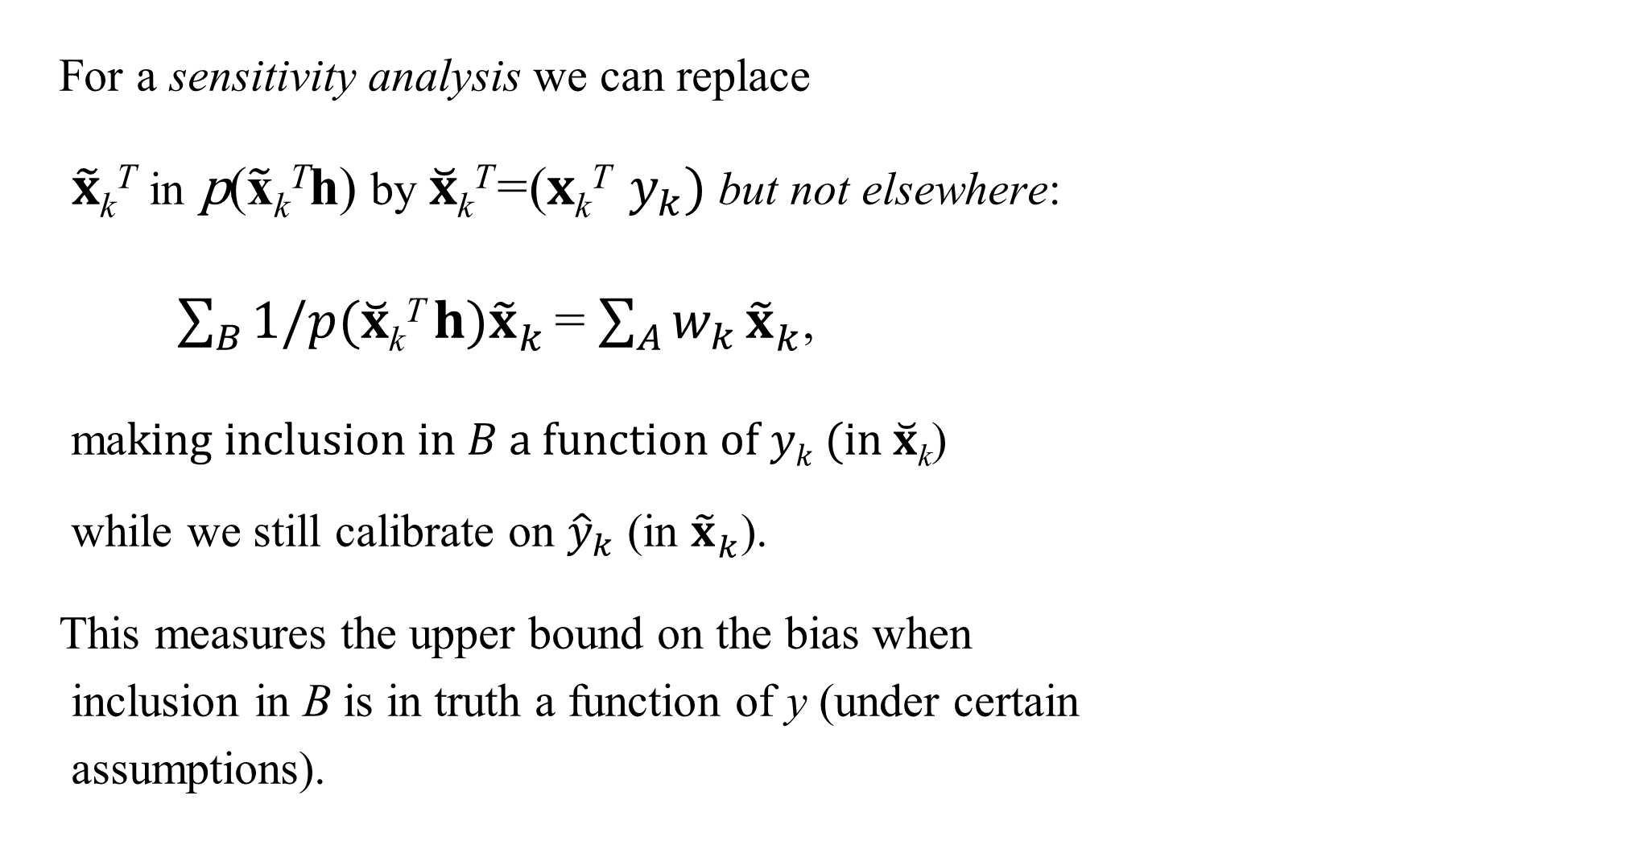
My Approach − Finally
For a sensitivity analysis we can replace
$\tilde{x}$_{k}^{T} in $\text{p}\text{(}\tilde{\text{x}}\text{k}\text{T}\text{h}\text{)}$ by $\breve{x}$_{k}^{T}=($x$_{k}^{T} $y_{k})$but not elsewhere:
$\sum_{B}{1/p(\breve{x}\text{k}\text{T} h}){\tilde{x}}_{k}^{ }$ = $\sum_{A}{w_{k}}{\tilde{x}}_{k}^{ }$,
ma$king inclusion in B a function of yk (in \breve{x}$_{k})
while we still calibrate on ${\hat{y}}_{k}$ (in ${\tilde{x}}_{k}^{ }$).
This measures the upper bound on the bias when
inclusion in B is in truth a function of y (under certain
assumptions).

Slide 11
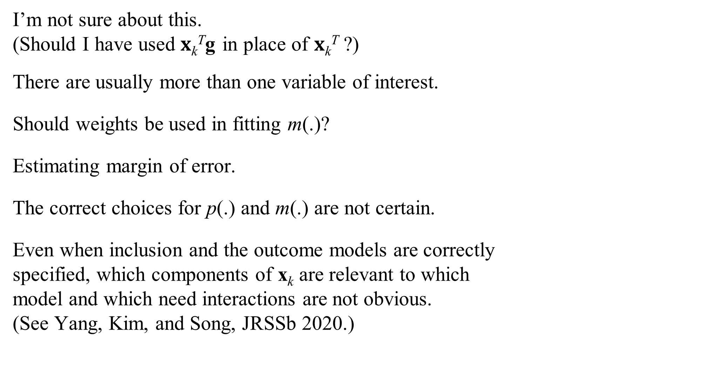
Problems, Problems
I’m not sure about this.
(Should I have used $x$_{k}^{T}g in place of $x$_{k}^{T} ?)
There are usually more than one variable of interest.
Should weights be used in fitting m(.)?
Estimating margin of error.
The correct choices for p(.) and m(.) are not certain.
Even when inclusion and the outcome models are correctly
specified, which components of x_{k} are relevant to which
model and which need interactions are not obvious.
(See Yang, Kim, and Song, JRSSb 2020.)

